Slide 1

CS-401
Computer Architecture & Assembly Language Programming
Lecture-34
DOS Services
Secondary Storage

Slide 2

Lets revise the last lecture

Slide 3
DOS services

Slide 4
Secondary Storage

Slide 5
int 0x21 DOS Services
Read Char from std Input with Echo
AH = 0x01
Return
AL = char read

Slide 6
int 0x21 DOS Services
Write String to std Output
AH = 0x09
DS:DX = ‘$’ terminated string address

Slide 7
int 0x21 DOS Services
Buffered Input
AH = 0x0A
DS:DX = buffer
Return
buffer = DS:DX filled with input

Slide 8
DOS Input Buffer
size
char read
data
. . . . . . . . . . . . .
data
00
01
02
n+1

Slide 9
Disk Formation

Slide 10
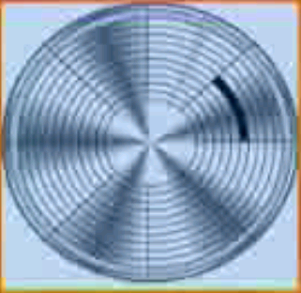
Disk Formation

Slide 11
Disk Formation
2 heads
80 tracks
18 sectors/track
bytes/sector
2880 total sectors
1440 K total bytes

Slide 12
Disk Formation

Slide 13
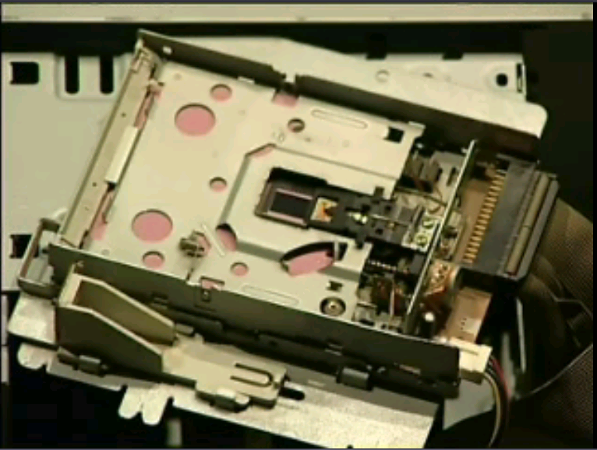
Floppy Drive

Slide 14
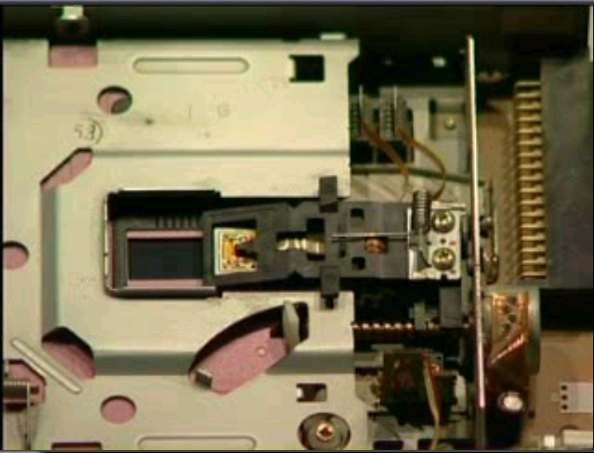
Floppy Drive

Slide 15
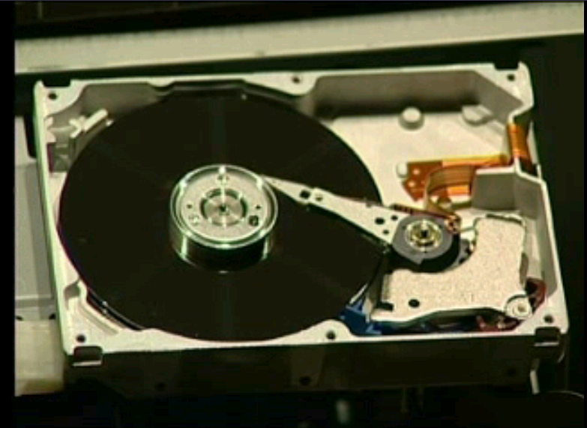
Hard Disk Drive

Slide 16
MS DOS Logical Formation
Boot
FAT 1
FAT 2
Root Dir
Data
Head 0 Track 0 Sector 1
Head 0 Track 0 Sector 2
Head 0 Track 0 Sector 11
Head 1 Track 0 Sector 2
Head 0 Track 1 Sector 16
Head 1 Track 79 Sector 18

